Slide 1


micro:bit entry video tutorial
Lesson 23
micro:bit creative lesson 23
“Beating of two hearts”
YahBoom micro:bit creative tutorial

Slide 2
micro:bit entry video tutorial
Content
Part1
Part 2
Part3
Part 4
Learning goals
Preparation
Search for blocks
Combine blocks
YahBoom micro:bit creative tutorial

Slide 3
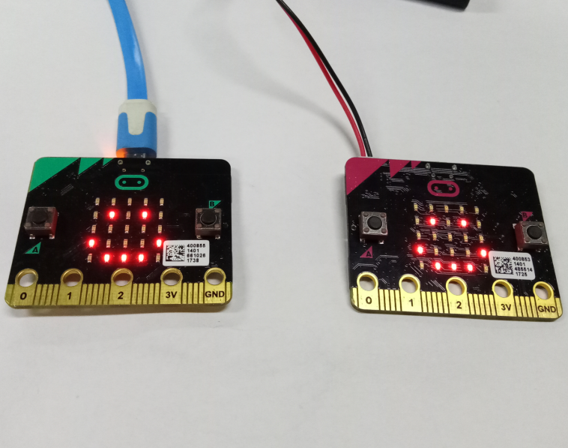
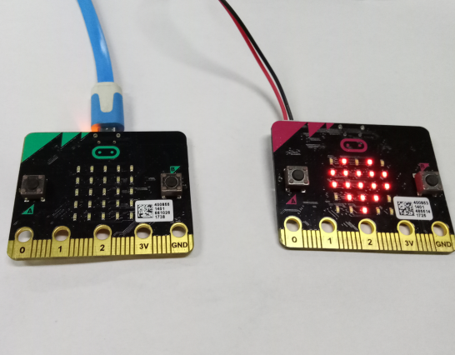
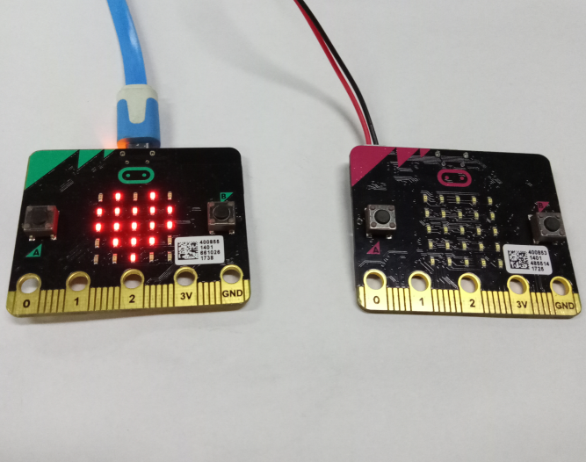
micro:bit entry video tutorial
Part 1
Learning
goals
This experiment requires two micro:bit board. First, you need to download the same wireless communicationcode in two micro:bits, then you should press one of the micro:bit A keys. The heart appears on another micro:bit dot matrix, when you press the B button, the heart appears on this micro:bit dot matrix,valid in the 50 meter range.
YahBoom micro:bit creative tutorial

Slide 4
micro:bit entry video tutorial
Part 2
Hardware:
● 2 x Micro:Bit Board
● 1 x USB cable
● 1 x PC
Preparation
Then the micro:bit is connected to the computer through USB, and the computer will pop up a U disk and click the URL in the U disk to enter the programming interface.
YahBoom micro:bit creative tutorial

Slide 5
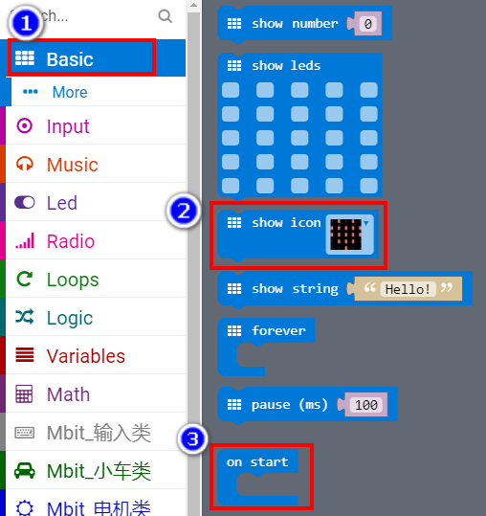
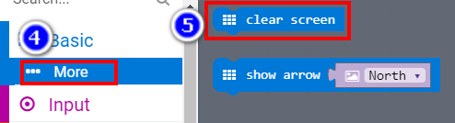
micro:bit entry video tutorial
Part 3
Search for
blocks
YahBoom micro:bit creative tutorial

Slide 6
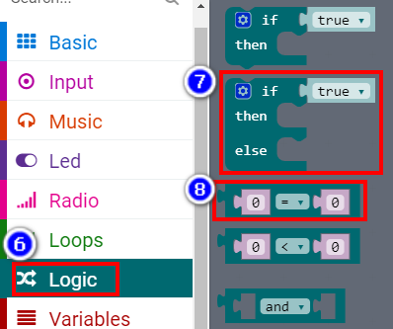
micro:bit entry video tutorial
Part 3
Search for
blocks
YahBoom micro:bit creative tutorial

Slide 7
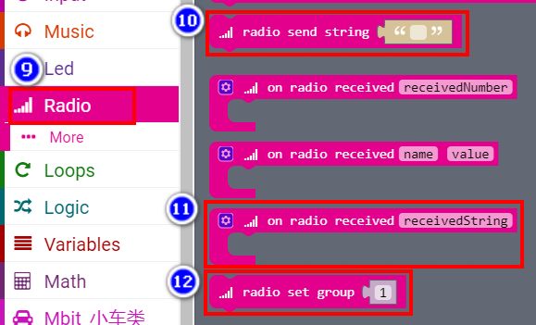
micro:bit entry video tutorial
Part 3
Search for
blocks
YahBoom micro:bit creative tutorial

Slide 8
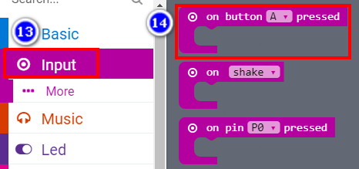
micro:bit entry video tutorial
Part 3
Search for
blocks
YahBoom micro:bit creative tutorial

Slide 9
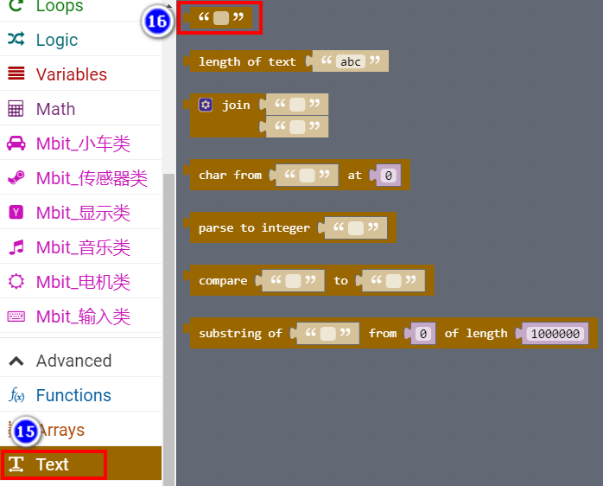
micro:bit entry video tutorial
Part 3
Search for
blocks
YahBoom micro:bit creative tutorial

Slide 10
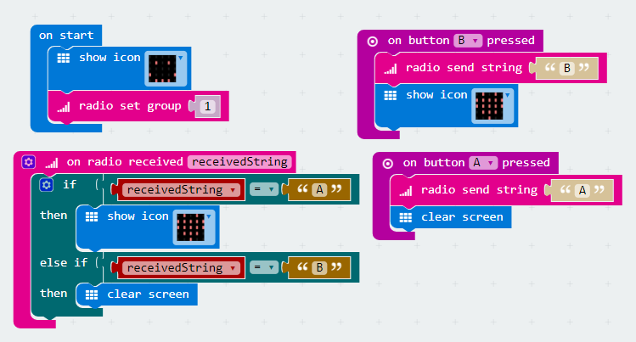
micro:bit entry video tutorial
Part 4
Combine
blocks
YahBoom micro:bit creative tutorial

Slide 11
micro:bit entry video tutorial
micro:bit
project
Thanks for watching!
Powered by
YahBoom
YahBoom micro:bit creative tutorial

